Slide 1

OLIPPADI
Team Members:
1.Miruthuvikasini.S -18BCS021
2.Abinayasri.N -18BCS033
3.Pragathi.R -18BCS038
4.Jenfero.N -18BCS043
5.Shalini.R -18BCS091

Slide 2

OBJECTIVE
The main objective of the OLIPPADI is to provide technical support to order the printouts through online applications .
To develop a comfortable platform by providing high profile website and to improve the service of OLIPPADI in effective ways.
The students and faculty can place their order from anywhere anytime inorder to reduce the physical apperance in the OLIPPADI

Slide 3
INTRODUCTION:
Olippadi, -is the Tamil translation of the word photocopy -the print house is a campus start up and its one of a kind in Kumaraguru College Of Technology . The most familiar start-ups are only food outlets but this one is a Reprography start-up.
In order to take printouts the students and faculty feels difficult to go out and take printout but this name OLIPPADI becomes the solution for their problem .

Slide 4
In order to make it more simple and comfortable platform to use ,the OLIPPADI website we provide will help the user to get their printouts instantly .Our website provides the friendly platform for all the students and faculty .We provide a user efficient platform to select the necessary document and get their printouts as they require.

Slide 5
PURPOSE:
The OLIPPADI has been successfully running in KCT since 2017.But still now there is no technical support provided for OLIPPADI to order printouts through online applications .our proposed system provides the significant way for customers to get their required documents without any man power .

Slide 6
Our OLIPPADI website helps the user to order the printouts in bulky orders. This Reduces the manpower in every possible ways and Makes the job more easy and convenient. OLIPPADI website provides separate order number for each orders in order to avoid confusion and also the payment is made simple by online method .

Slide 7
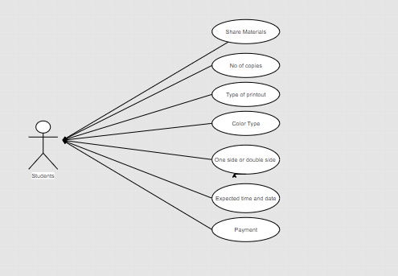
USECASE DIAGRAM:

Slide 8
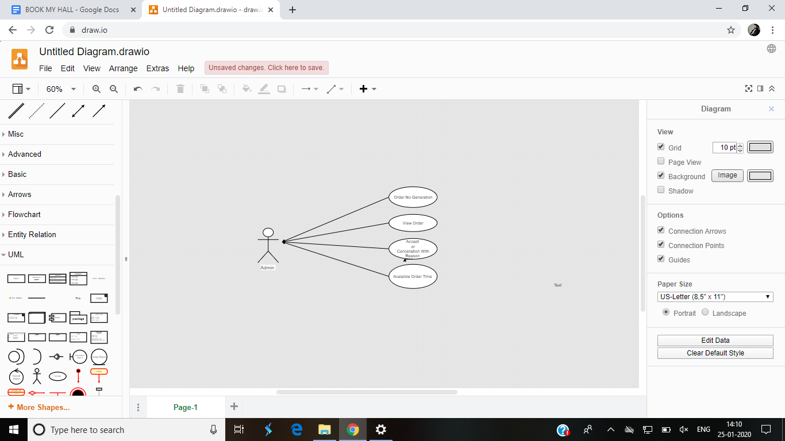
USECASE DIAGRAM:

Slide 9
MODULES INVOLVED:
1.User Registration:
When user will open the URL of website, GUI should popup for registration.
GUI will include the basic information about user such as: User Name, E-mail ID,Address, Contact number, Password, City,State, Country etc.
All information related to the user, which he/she has entered into the GUI, should store into the relational database.

Slide 10
2.User Login:
When user will login into the website, there should be a tool to open account settings for the user. User should able to change the profile features such as, password, contact number, mail id etc. All the modified features should be updated into the database.
When a user opens the URL of a website, GUI should popup for Log-in. There should be options like User-ID and Password to login into the website.
User-ID should be unique into the database.
If a user enters wrong information, it should give an alert or, popup for wrong inputs.
After successful login users should redirect to the home page.

Slide 11
3.Uploading the Document:
User can upload a document they needed and an option called “SUBMIT” is mandatory for the confirmation.
4.Type of the Document:
User can specify the No of copies,colour of the xerox and printouts, specifications like portrait or landscape,
One sided or double sided etc..,

Slide 12
5.Delivery Time:
Users can specify the time,when the document is needed. The admin can also change that time and send it to the required user when it will be available.
6.Send Bill via Mail:
The amount for the order can be send to the user through their mail specified .

Slide 13
7.Comment Session:
This feature is used to gain information from th user regarding the cons and flaws in the website
8.View and download :
This feature allow admin to pre view the document to be printed so that he can avoid the fake order.

Slide 14
9.Home Page GUI Design:
Additional features such as, company name,
logo, tool assumptions etc. shall be
required.
10. User Logout:
Only if user is login into the website, then logout tool/button should be visible otherwise it shall be void.

Slide 15
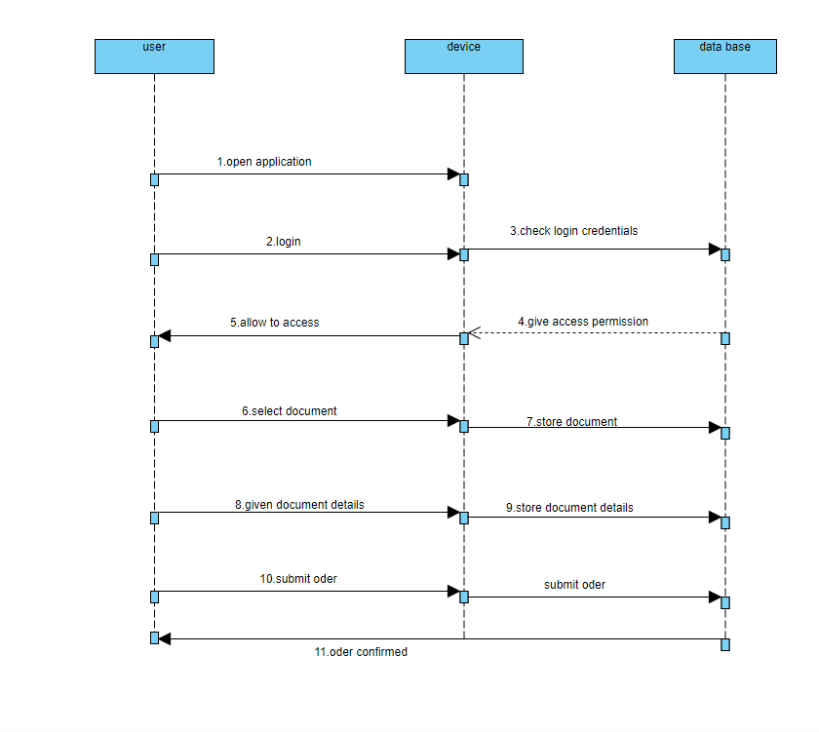
Sequence Diagram:

Slide 16
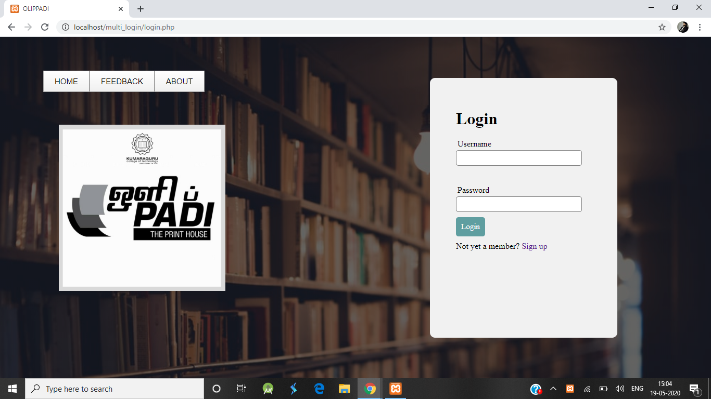
Home Page:

Slide 17
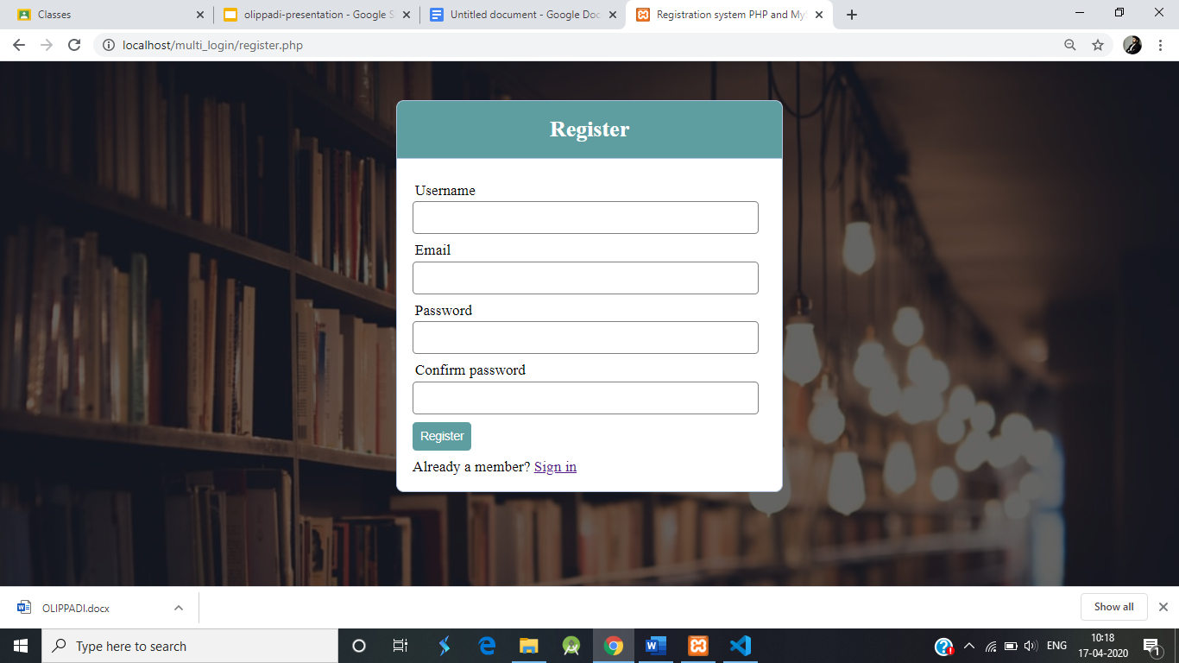
Registration form:

Slide 18
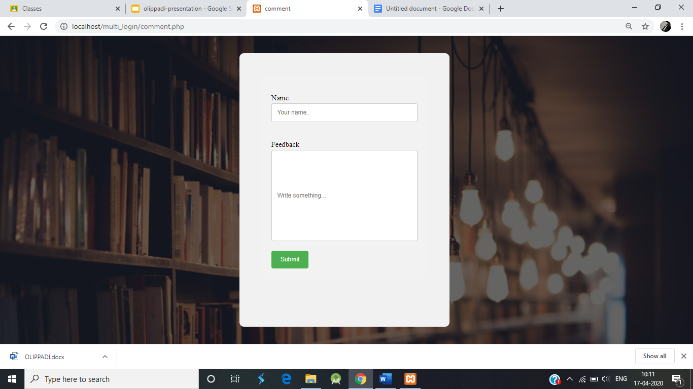
Feedback Form:

Slide 19
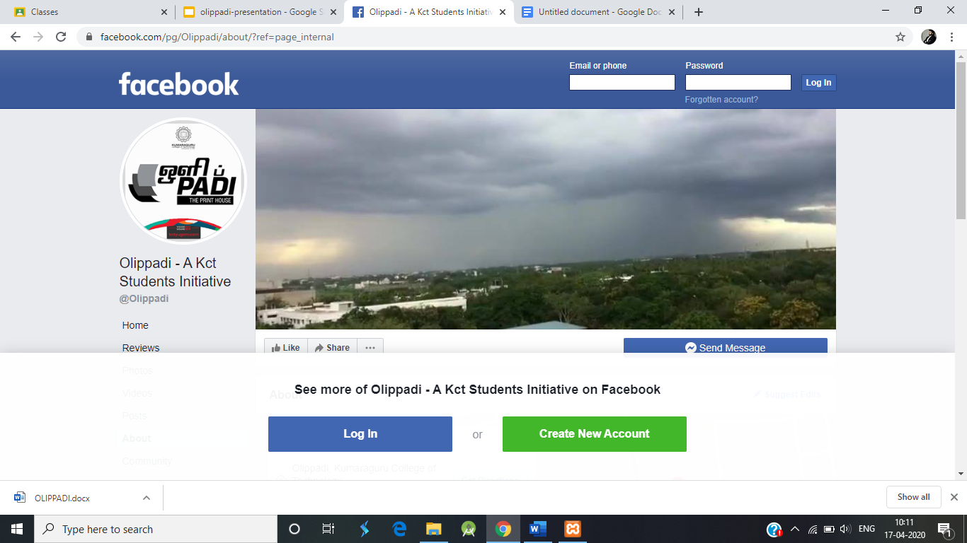
About Us page:

Slide 20
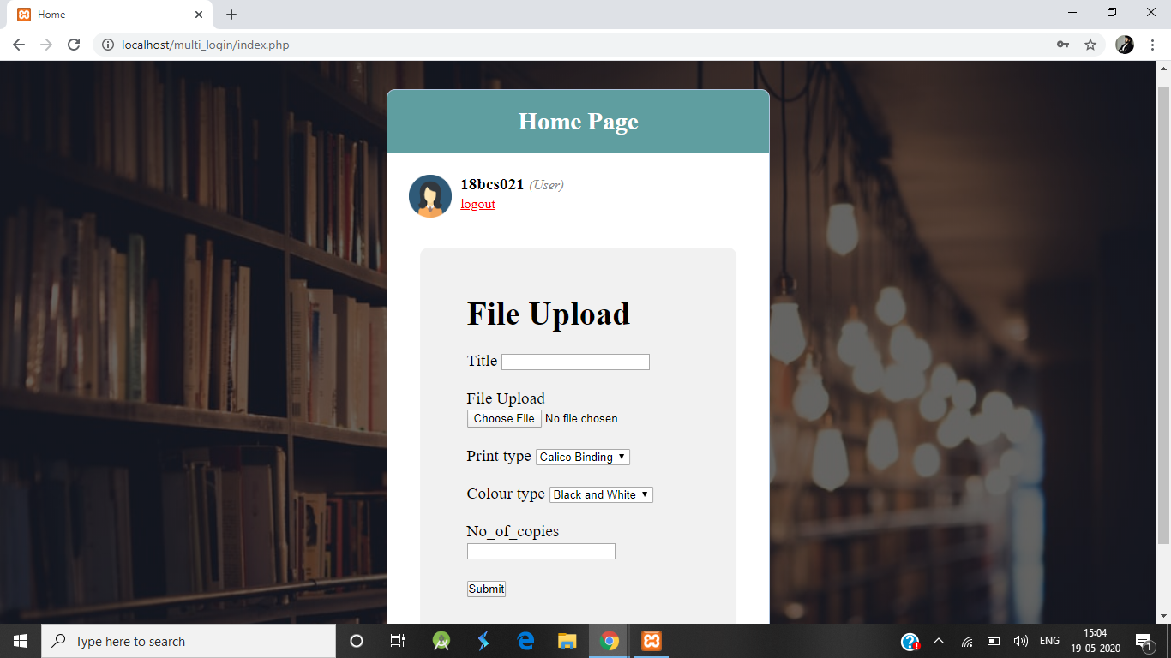
User login first page and File Upload:

Slide 21
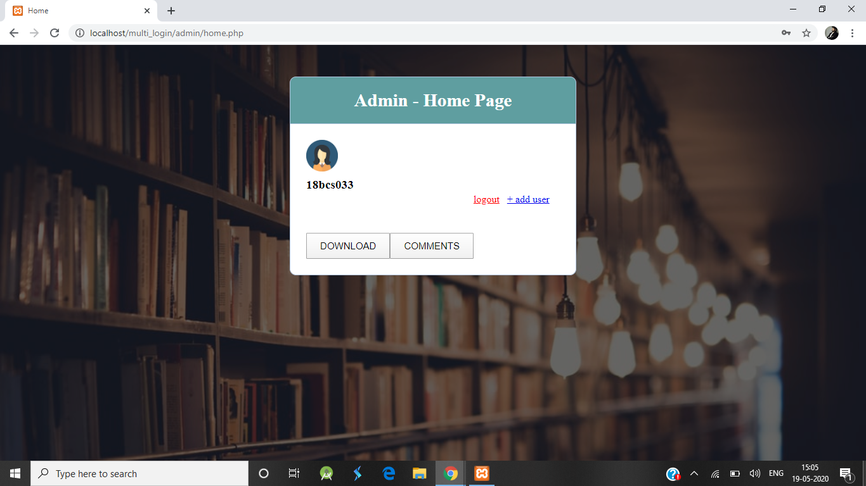
Admin First page :

Slide 22
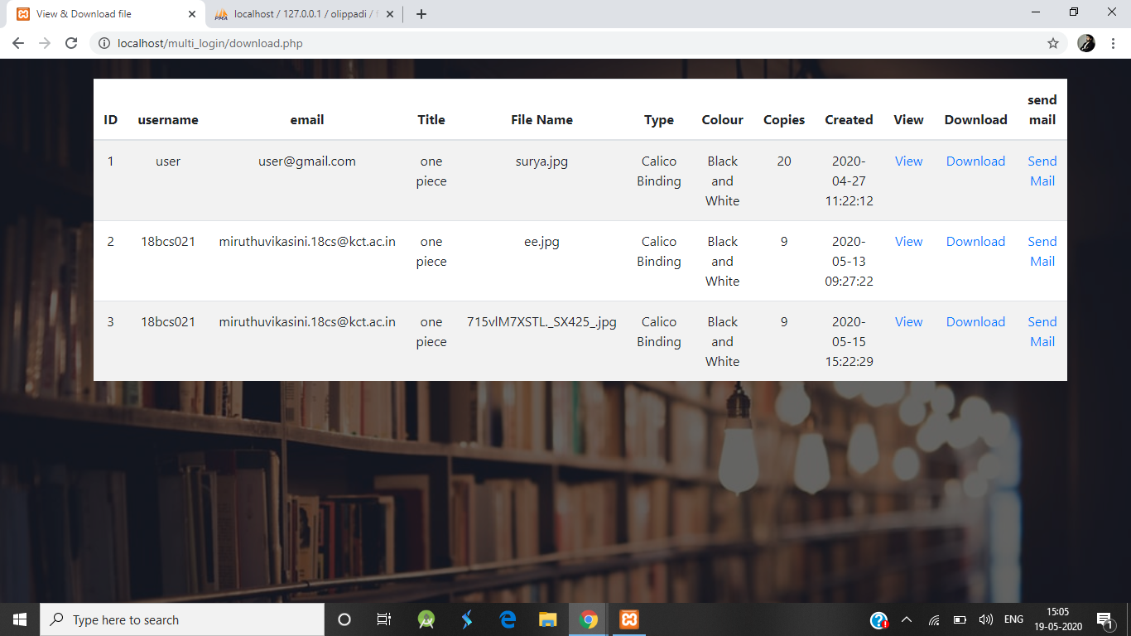
Admin Page to view History of the order :

Slide 23
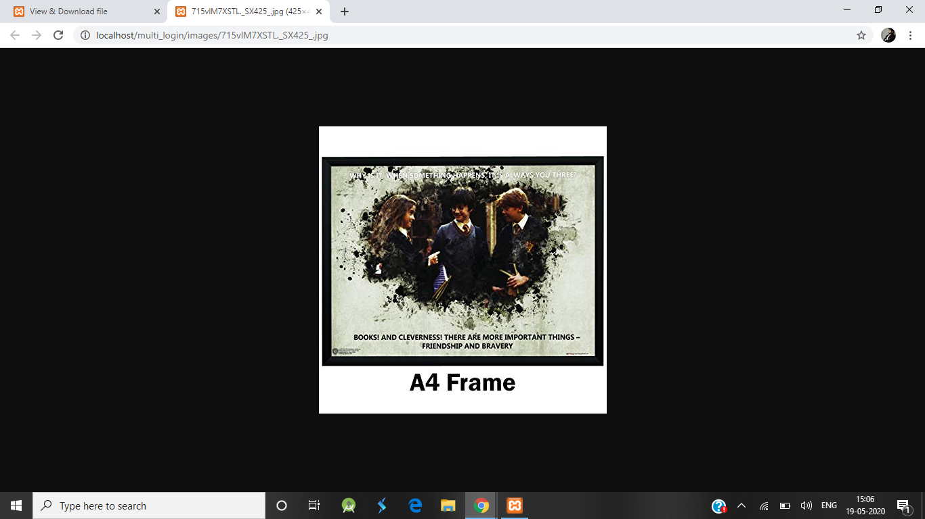
Preview of the document submitted:

Slide 24
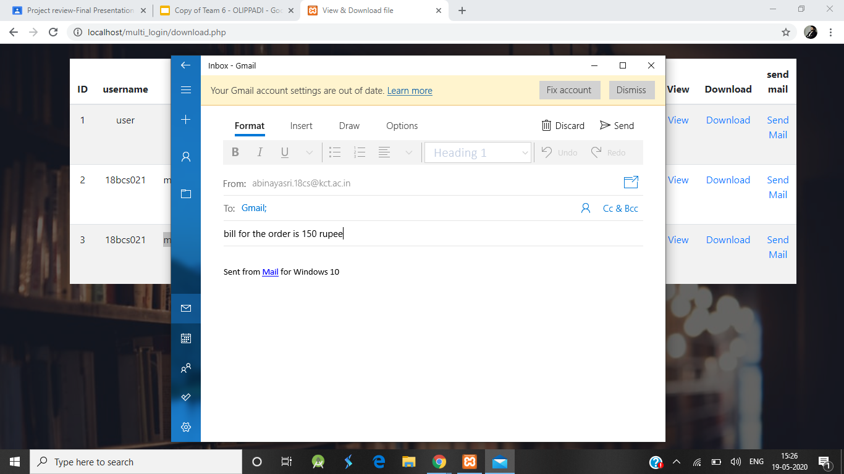
Sending bill via mail:

Slide 25
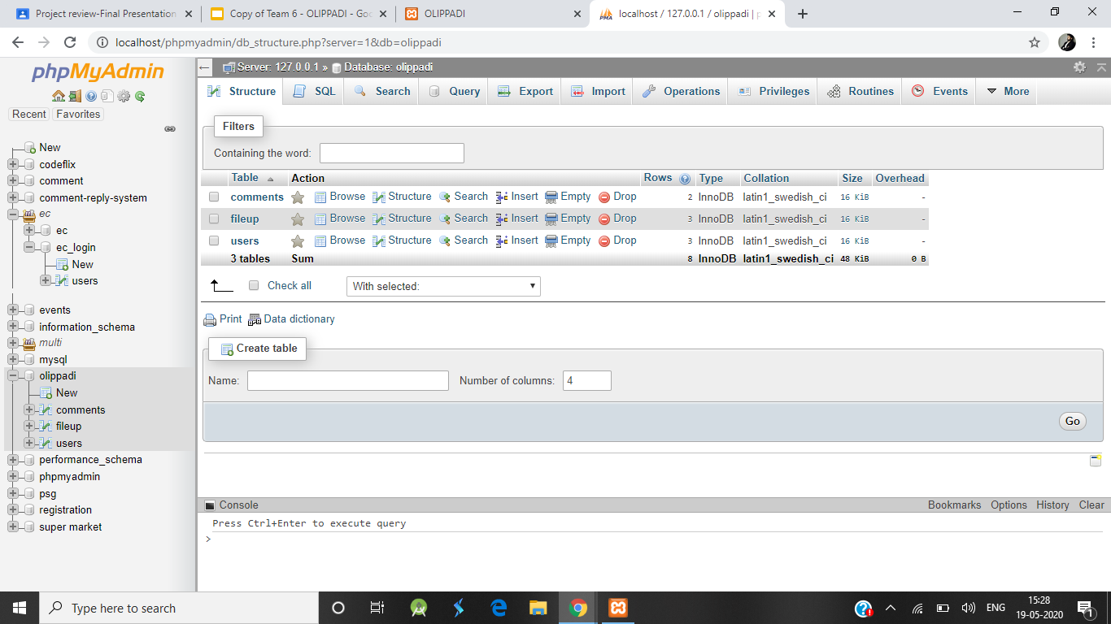
database:

